Slide 1
TOPIC A:
DATABASES
LESSON A-3
DATABASE MANAGEMENT SYSTEMS

Slide 2
AGENDA
Warm-up Question
Database Management Systems (DBMS)
Relational Database Management Systems (RDBMS)
Functions of DBMS
DBMS Security
NOTE!
Have a way to take notes available for this lesson, and your computer for a lab

Slide 3

THE WARM UP QUESTION
Decide if the data is invalid for a database field based on Consistency or Integrity:
HasCheckedIn: Joe
SSN: 555-555-5555
DOB: 14/14/2025
NumStudents: 20.5

Slide 4
THE WARM UP ANSWER
HasCheckedIn: Consistency
SSN: Integrity
DOB: Integrity
NumStudents: Consistency

Slide 5
DBMS
A DBMS (Database Management System) is a software system that manages, stores, and retrieves data efficiently in a structured format
It allows users to create, update, and query databases efficiently
Ensures data integrity, consistency, and security
Reduce data redundancy and inconsistency using a centralized model
Supports concurrent access, transactions, and backups

Slide 6
RDBMS
A RDBMS (Relational Database Management System) is a type of DBMS that works with relational databases
Relational Databases store and retrieve data using a format of rows and columns
These look somewhat like a spreadsheet
Most modern database management software is RDBMS
In RDBMS different tables can refer to each other (hence relational) which allows for complex operations

Slide 7
DBMS FUNCTIONS
A DBMS serves many functions
Ability to create a database and the tables inside of it
Add new data to an existing table
Delete data from a table (or tables entirely)
Update data in a table
Query (get) data from a table
Manage security of database
Make and use database backups

Slide 8
DBMS SECURITY
DBMS can also control the security of a database in many ways
Authentication in the program prevents unauthorized access
Rules can be set in place for which accounts can access which parts of the database
Databases can be encrypted
DBMS can track activity on the database to detect unusual activity
Databases can protect data by creating backups

Slide 9
DBMS SECURITY
The reliability of the database is often just as important as the security
A DBMS can also ensure that data is validated before it enters the database
DBMS can also protect fields while they are being concurrently accessed to ensure transactions remain atomic

Slide 10
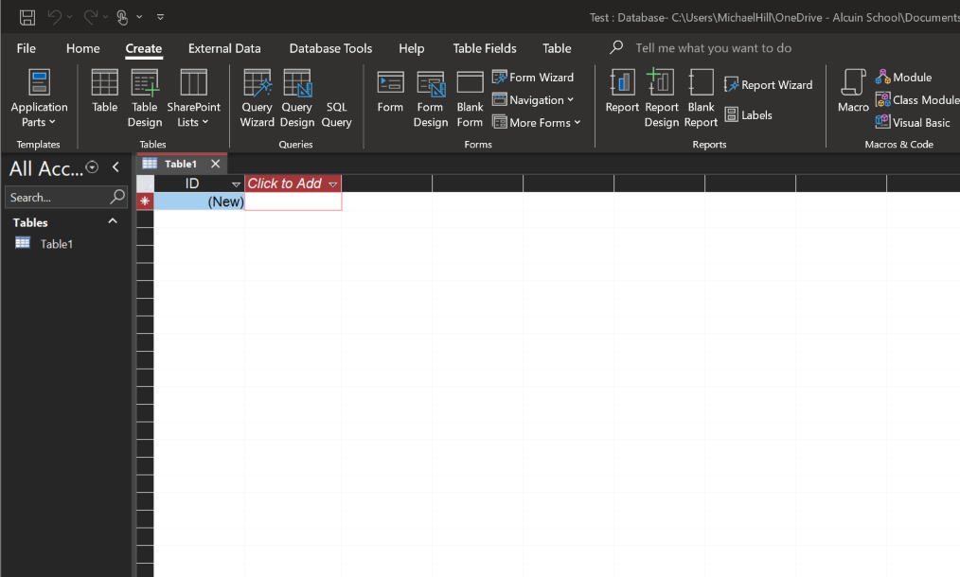
ACCESS LAB
Let’s fire up our school-purchased DBMS, Microsoft Access!
You’ll see that it looks a lot like Excel, or Google Sheets

Slide 11
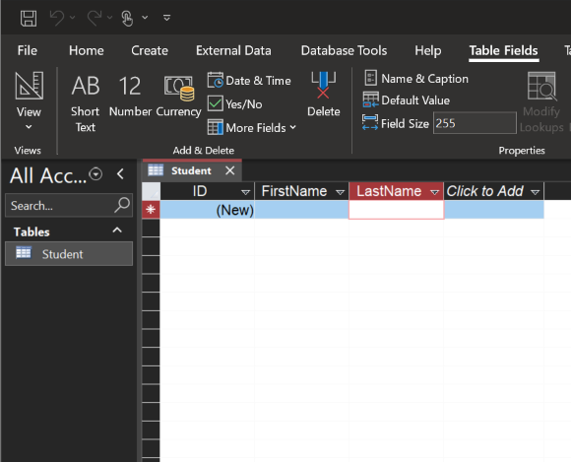
ACCESS LAB
A table is created by default called Table1, and it has a field called ID
Let’s right click this table’s tab to save it as “Student”
Let’s give it a first name and a last name field, click where it says “Click to Add” and select short text for each of these

Slide 12
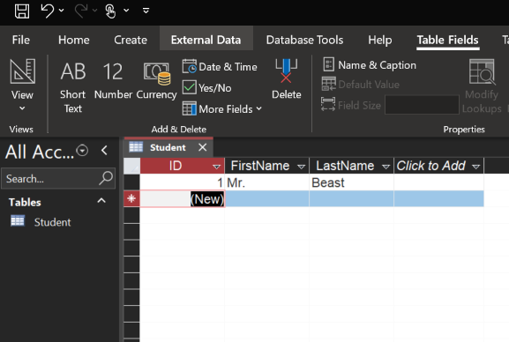
ACCESS LAB
Go ahead and add a record with a first and last name, you’ll notice that ID is automatically going to be set to 1 and you can’t change it
ID is a field managed by the DBMS to ensure each record has a unique one
It is also known as a Primary Key

Slide 13
ACCESS LAB
If we click on one of these fields, say FirstName, then we can modify how long the data stored in our field is, as well as change the data type using a dropdown
There are checkboxes that let you specify if a field is required (has to be filled for each record), unique (must not have the same value as another record in that field), and indexed (like our ID field)

Slide 14
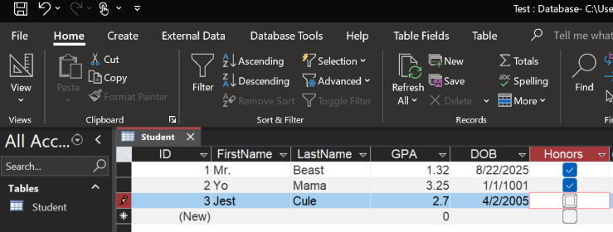
ACCESS LAB
Let’s go ahead and fill this table out with a DOB field, a GPA field, and an Honors field
Right click on the table to open it in design view – this will allow you to make GPA a decimal
Put in some dummy data for a few students, make sure that there are lots of different options

Slide 15
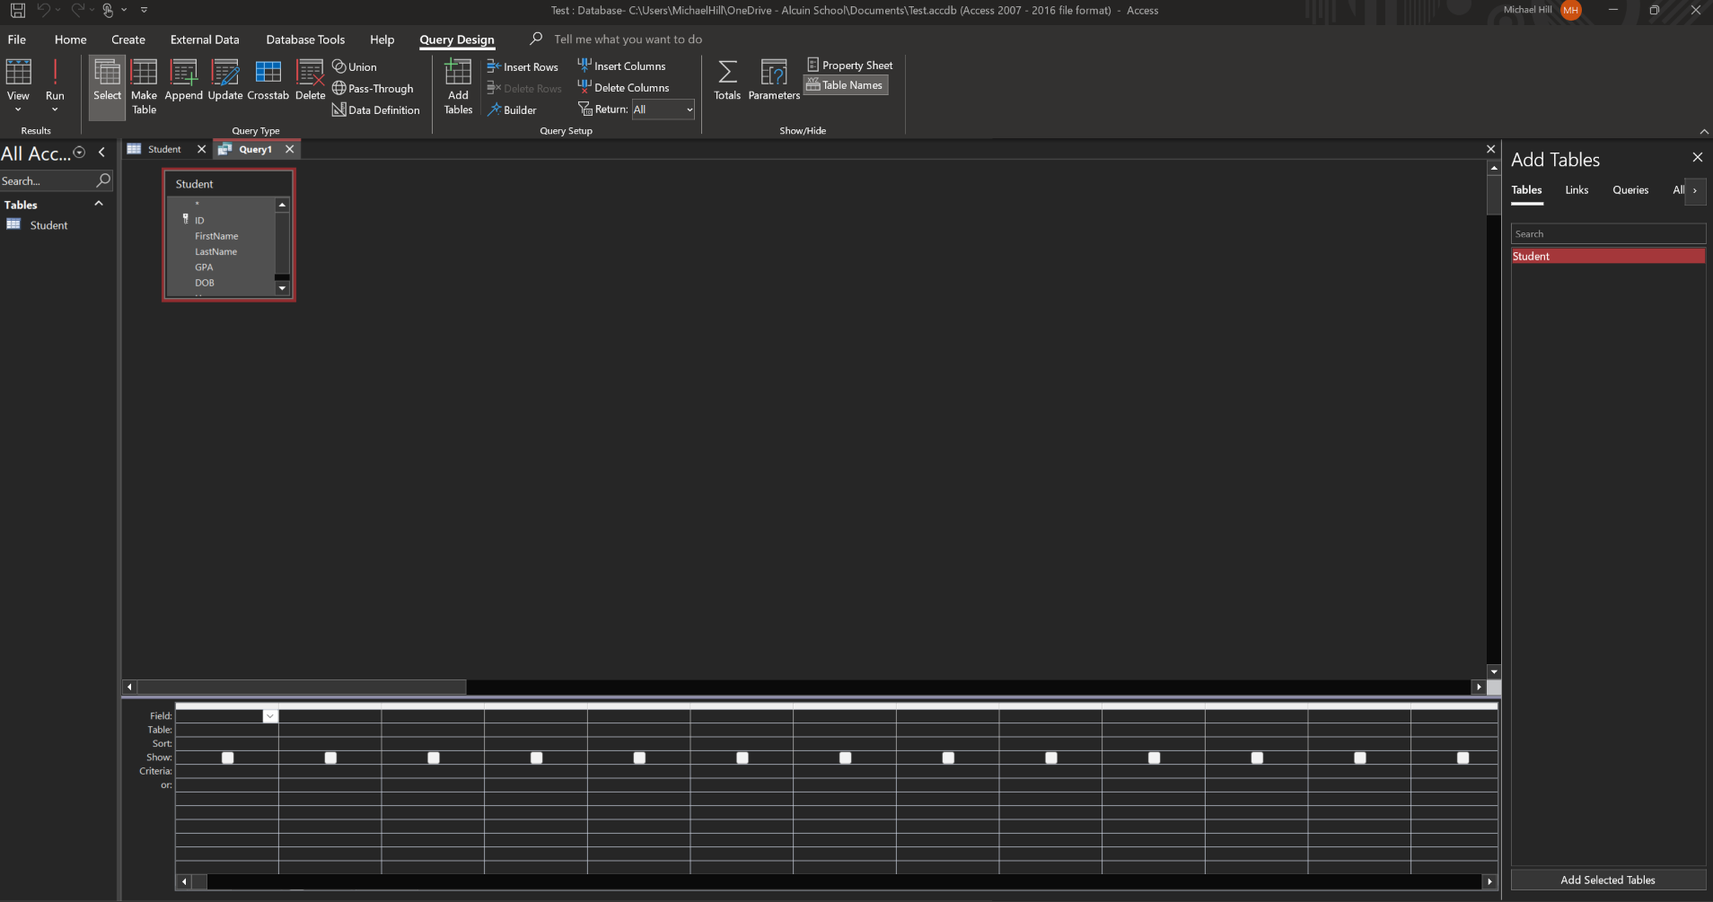
ACCESS LAB
Now, let’s test out a simple query
Go to the ‘create’ table and select ‘query wizard’
The bottom of the screen will have a grid where you can decide what information you want returned in your query
Double-click on your table name on the right side to get it to show up

Slide 16
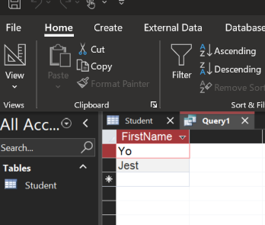
ACCESS LAB
Then, select in the first row that you want to get FirstName
In the second row, select GPA
Check the “Show” box for FirstName, but not GPA
Add “>2” on the criteria field on GPA
Click the run button at the top right, and you’ll get a list of all student first names with a GPA over 2

Slide 17
ACCESS LAB
Congratulations! You have queried your first database
On the backend, Access converts this into a language called SQL (Structured Query Language), which then gets information from the database
Right click the tab to see the SQL view and you can see what it converted it to
We will write our own SQL soon!

